Slide 1
Sipna College Of Engineering &
Technology, Amravati
Image Analytic For Classifying Data Sets For Large Class
Guided By
Prof. A. A. Bardekar
Presented By:
Mr. Pranav R. Mundre Mr. Pratik N. Dangore
Mr. Vishal G. Inzalkar Mr. Kartik N. Kalpande
Mr. Nikhil V. Rathod Mr. Aditya D. Sontakke

Slide 2
Content
Introduction
Application
Advantages & Disadvantages
Project Overview
Conclusion

Slide 3
Objective
Objective of our project is to design software that can detect face an image and predict Whose are they?

Slide 4
Why we chose Image Analytics Project?
Compatible with modern Era.
Security Maintenace and Media Empowering.
Needed for visual application in Robotics.

Slide 5
Introduction
Image analysis
Image analysis is the extraction of meaningful information from images.
Image analysis tasks can be as simple as reading bar coded tags or as sophisticated as identifying a person from their face.
Data Set
A data set is a collection of related, discrete items of related data that may be accessed individually or in combination or managed as a whole entity.

Slide 6
What is Image Analytics?
Image analytics is the automatic algorithmic extraction and logical analysis of information found in image through digital image processing techniques.
Image analytics can also identify faces within photos to determine sentiment, gender, age, and more.
It can recognize multiple elements within a photo at the same time, including logos, faces, activities, objects, and scenes.

Slide 7
Digital Image
Digital images are made of picture elements called pixels. Typically, pixels are organized in an ordered rectangular array.
The size of an image is determined by the dimensions of this pixel array. The image width is the number of columns, and the image height is the number of rows in the array.
Image size specifically describes the number of pixels within a digital image.

Slide 8
Step by Step Analysis
Step 1

Slide 9
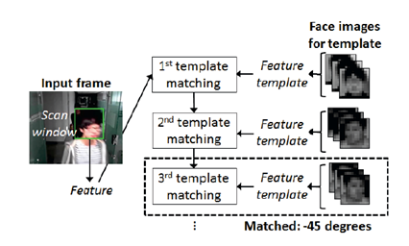
Template Matching
Template Matching uses pre-defined or parameterised face templates to locate or detect the faces by the correlation between the templates and input images.
Ex- a human face can be divided into eyes, face contour, nose, and mouth.

Slide 10
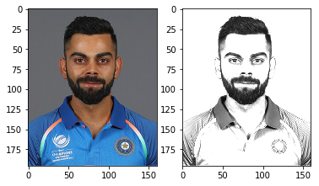
How the Face Detection Works
Firstly the image is imported by providing the location of the image.
Then the picture is transformed from RGB to Grayscale because it is easy to detect faces in the grayscale.

Slide 11
How the Face Detection Works
The next step is image segmentation, which is used for contour detection or segments the multiple objects in a single image so that the classifier can quickly detect the objects and faces in the picture.

Slide 12
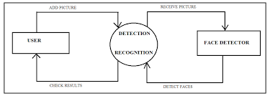
DFD For Detecting Face In Database

Slide 13
..
..

Slide 14
..
..

Slide 15
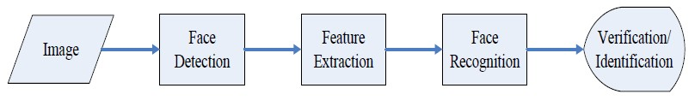
Process of Face Matching
Save Images To Database
Detect Faces
Match detected faces to Database
Recognize Faces
Provides accurate information about them

Slide 16
Project Specification
Tools & Technology
Operating System: Windows And Linux
Hardware Requirement: 2GB-RAM(Min), WebCam
Programming Language: Python
Computer Vision Library:
Open CV Library
Pillow

Slide 17
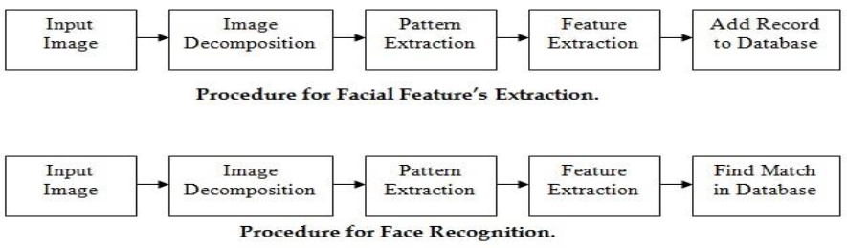
Project Overview

Slide 18
Advantages & Disadvantages
Advantages
Digital images can be processed by digital computers.
Images can be given more sharpness and better visual appearance
Minor errors can be rectified.
remove noises.
Image can be made available in any desired formats like black and white, negative image.
Disadvantages
It's very costly depending on the system used, the number of detectors purchased.

Slide 19
Application Of Image Analytics
Medical
Security
Astronomy
Defense
Self Driving Cars
Needed for visual appplication Robotics

Slide 20
Conclusion
The computational models, which were implemented in this project, were chosen after extensive research, and the successful testing results confirm that the choices made by the researcher were reliable.

Slide 21
Thank You…

